Slide 1
Where are we going to live next? A 10-city analysis to find the most desirable city to live in Data Analysis And Presentation by: Data_Slack{ers}=False Ben Schatz | Sean Daily | Vraj Patel | Ashley Cooper

Slide 2
Agenda
Dataset Overview
Hypothesis and Sub Questions
Roles
Analysis Summary
City Population
Cost of Living
Crime
Urban Connectivity
Conclusion
Questions
Data_Slack{ers}=False

Slide 3
Data Overview
Cost of Living in the US - total cost of living for housing cost, food, transit, childcare taxes and other necessities, 31430 rows x 15 columns Crime Rate for Each City - major crime rate for each city, 100 rows x 14 columns
Urban Connectivity - includes the city walk score, transit score and bike score, 102 rows × 79 columns Population of all US Cities 2024 - population growth of the city from 2020-2024, 300 rows x 8 columns
Source: Kaggle
Data_Slack{ers}=False

Slide 4
Hypothesis and Sub Questions
Hypothesis: Nashville is the most desired city to live in based on its ranking for cost of living, crime rate, total urban connectivity score and population.
10 Cities: Atlanta, Austin, Boston, Chicago, Denver, Los Angeles, Nashville, New York, San Diego and Tampa
Questions
1.) Will our most desirable city be a large or small city based on population?
2.) As the population increases in the city does the major crime rate increase for the city?
3.) As the population increases in the city does the walk score for the city increase?
4.) As the population increases in the city does transit score decrease for the city?
5.) As the population increases in the city does the bike score increase for the city?
6.) As the population increases in the city does the housing cost grow for the city?
7.) As the population increases in the city does the total cost of living increase for the city?
Data_Slack{ers}=False

Slide 5
ROLES
Task(s) | Team Member(s)
Exploratory Data Analysis | Ben Schatz, Sean Daily, Vraj Patel, Ashley Cooper
Jupiter Notebook – Code Merge | Ben Schatz
Summary Analysis Report | Vraj Patel, Sean Daily
Slide Deck | Ashley Cooper
Data_Slack{ers}=False

Slide 6
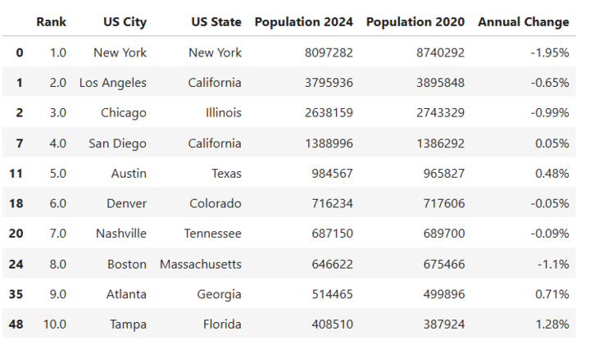
CLEANING Data – CITY POPULATION
https://www.kaggle.com/datasets/dataanalyst001/population-of-all-us-cities-2024/data
Data_Slack{ers}=False

Slide 7
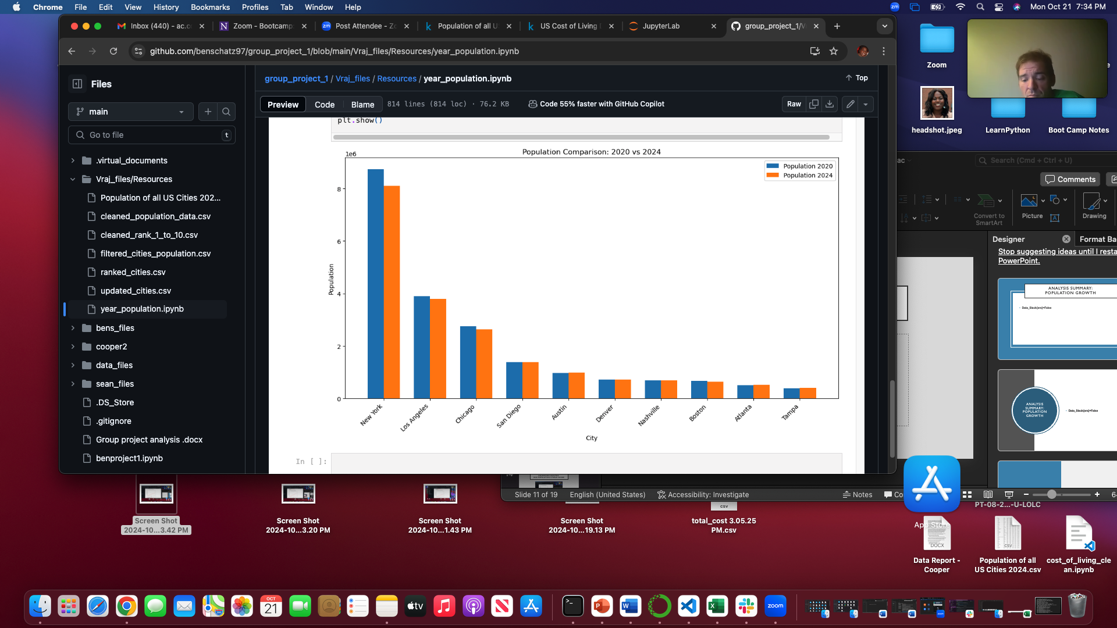
CITY Population Growth
Data_Slack{ers}=False

Slide 8
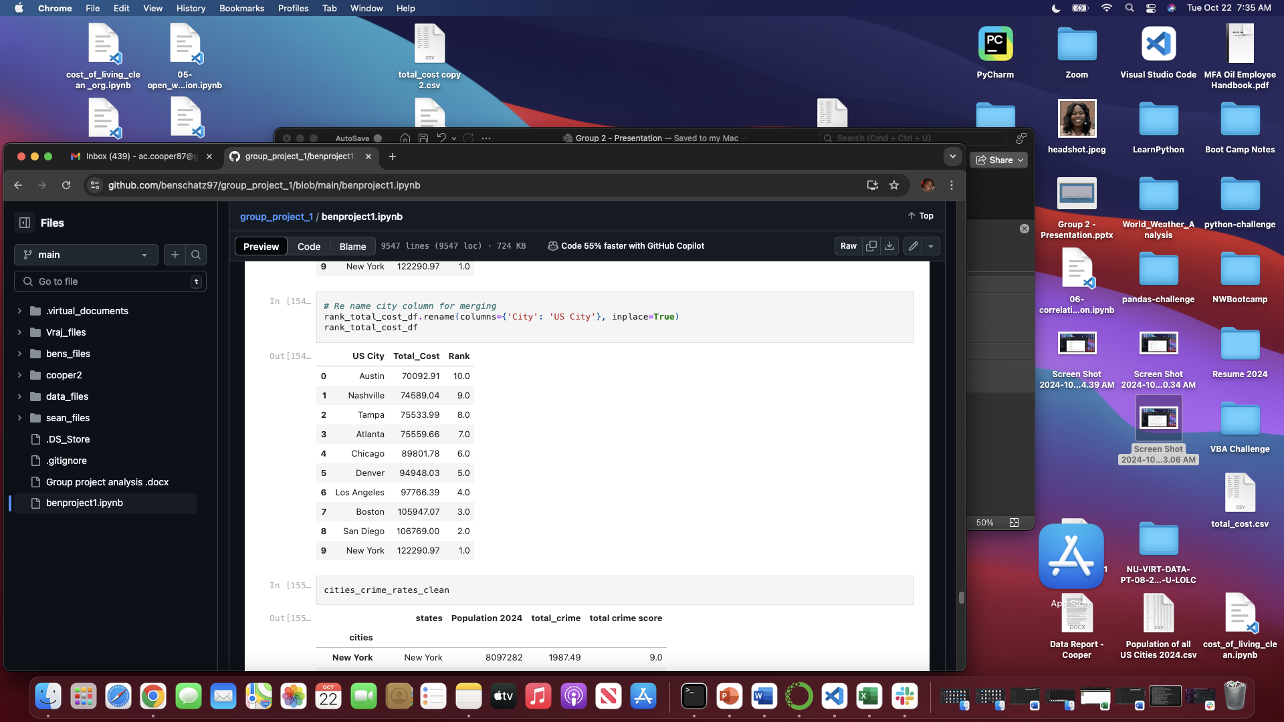
DATA CLEANING – COST OF LIVING
https://www.kaggle.com/datasets/asaniczka/us-cost-of-living-dataset-3171-counties
This dataset contains estimated family budgets for 1,877 counties across the U.S., with costs broken down by housing, food, transportation, health care, other necessities, and taxes. The dataset was built using the Economic Policy Institute’s (EPI) Family Budget Calculator. According to EPI:“The Family Budget Calculator measures the income a family needs to achieve a modest yet adequate standard of living. These budgets estimate community-specific costs for 10 family types (one or two adults with up to four children) in every U.S. county and metro area. Unlike the federal poverty line and the Supplemental Poverty Measure, EPI's family budgets offer a more accurate and comprehensive measure of economic security in America.” (Source: EPI Family Budget Calculator)
Data_Slack{ers}=False
Notes:
-Removed unwanted information and unnecessary columns -Used completed data sets, no missing information -Created new data frames using merge and dictionaries -Filtered, sorted and grouped data to only analyze 10-selected cities: Atlanta, Austin, Boston, Chicago, Denver, Los Angeles, Nashville, New York, San Diego, and Tampa.
The first dataset we used from Kaggle was the US Cost of Living Dataset (1,877 Counties). This dataset contains estimated family budgets for 1,877 counties across the U.S., with costs broken down by housing, food, transportation, health care, other necessities, and taxes. The dataset was built using the Economic Policy Institute’s (EPI) Family Budget Calculator.According to EPI:“The Family Budget Calculator measures the income a family needs to achieve a modest yet adequate standard of living. These budgets estimate community-specific costs for 10 family types (one or two adults with up to four children) in every U.S. county and metro area. Unlike the federal poverty line and the Supplemental Poverty Measure, EPI's family budgets offer a more accurate and comprehensive measure of economic security in America.” (Source: EPI Family Budget Calculator)This dataset is 31,430 rows and 15 columns. We found the dataset was more complete than others due to it not missing any data fields.We started by removing unnecessary columns to focus only on the data required for our analysis. The following columns were dropped: 'case_id', 'isMetro', 'family_member_count', 'county', and 'median_family_income'. Then we filtered the dataset to include only our 10 selected cities: Atlanta, Austin, Boston, Chicago, Denver, Los Angeles, Nashville, New York, San Diego, and Tampa. For some cities, there were multiple rows of data, likely due to being recorded at different times throughout the year. Since the dataset is based on annual information, we averaged the total costs across these multiple rows for each city to maintain consistency.After the previous cleaning steps, we were left with 650 rows and 10 columns.We then created a new data frame containing our selected cities and their total cost of living, which was used for the analysis supporting our hypothesis and research questions.We were curious about certain aspects of this dataset, such as:
Understanding why some cities had multiple rows of data.
Gaining more details on “other necessities.”
Obtaining information about the demographics of the families represented.
Exploring the possibility of additional data based on ZIP codes.

Slide 9
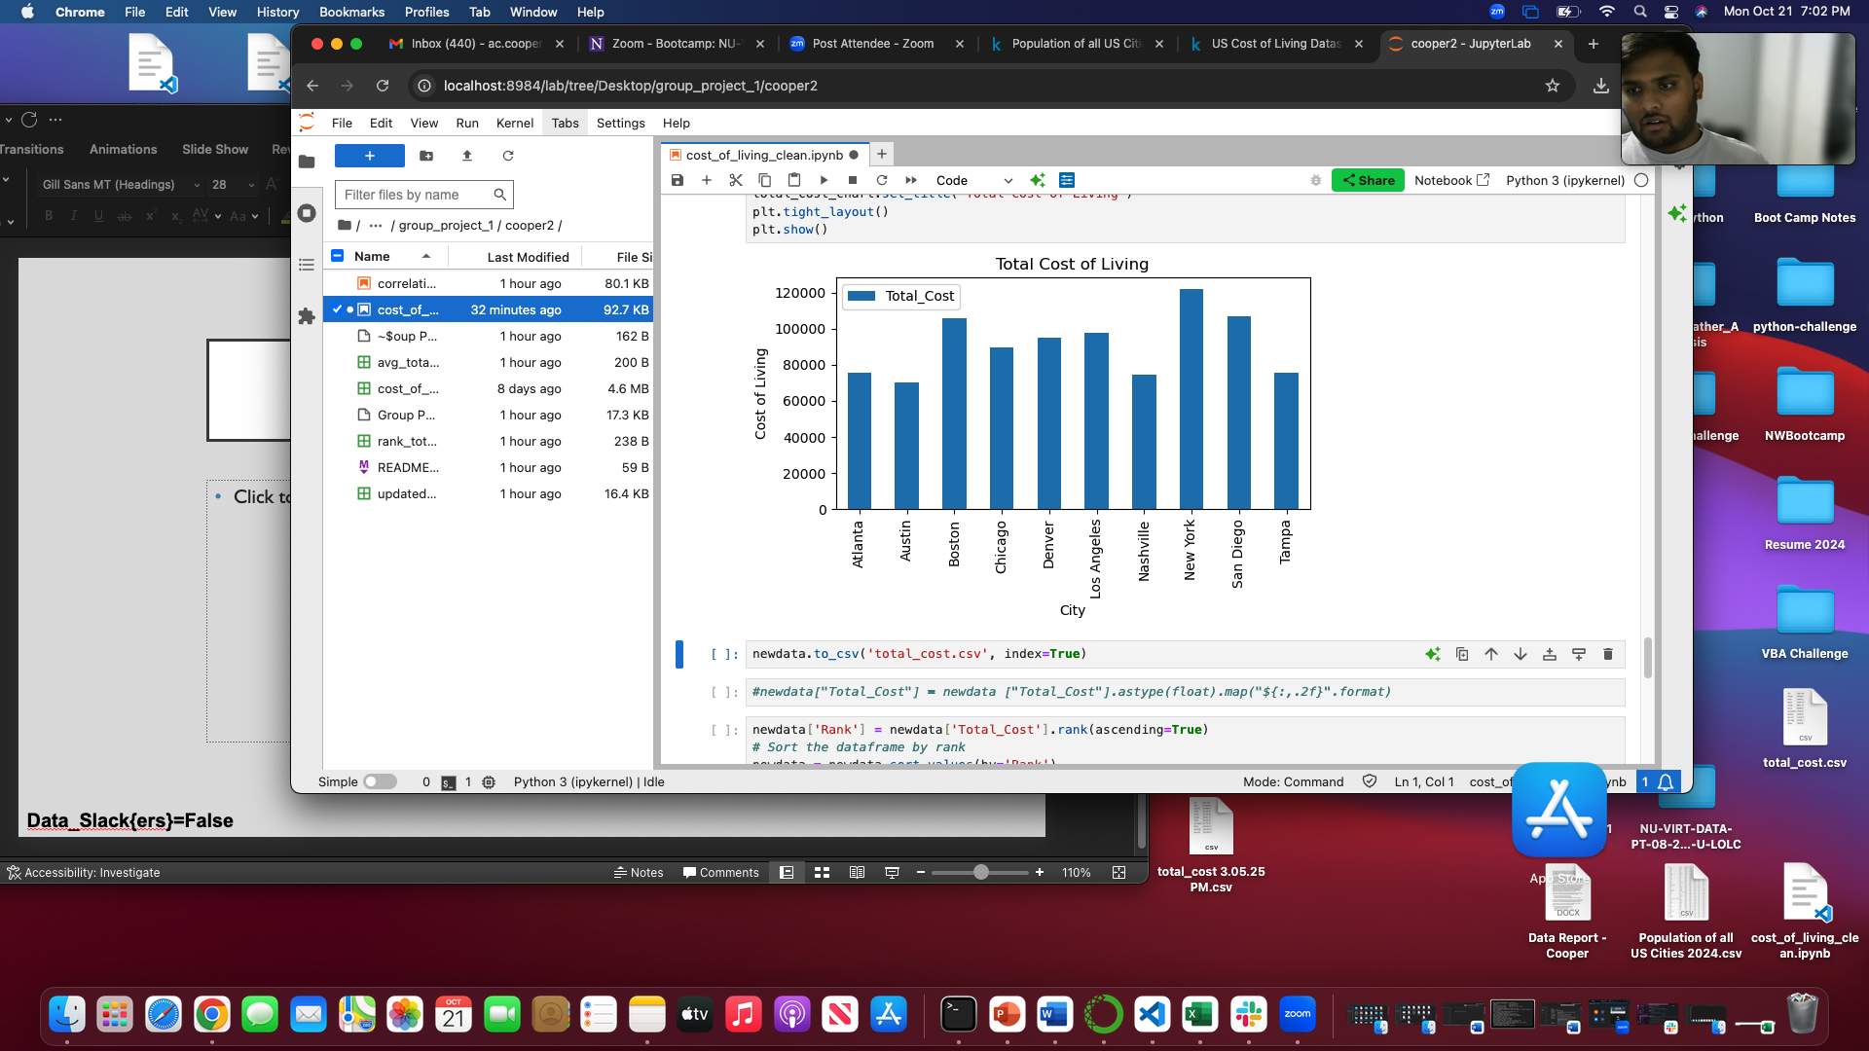
Cost of Living
City | Total Cost
Austin | $70,092.91
Nashville | $74,589.04
Tampa | $75,533.99
Atlanta | $75,559.66
Chicago | $89,801.78
Denver | $94,948.03
Los Angeles | $97,766.39
Boston | $105,947.07
San Diego | $106,769.00
New York | $122,290.97
Data_Slack{ers}=False

Slide 10
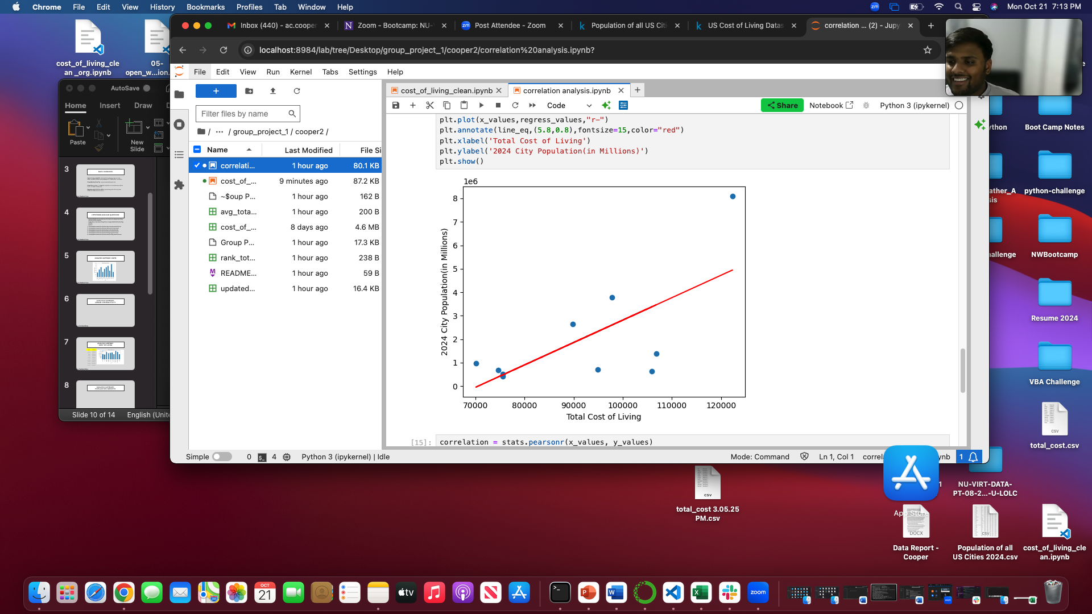
2024 CITY Population X Cost of LIVING R=.68
Data_Slack{ers}=False

Slide 11

COST OF LIVING RANK
Data_Slack{ers}=False

Slide 12
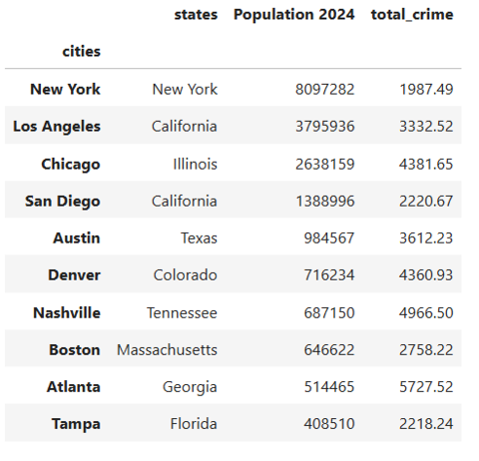
CLEANING Data – CITY CRIME RATE
https://www.kaggle.com/datasets/kabhishm/united-states-crime-rates-by-city-population
Data_Slack{ers}=False

Slide 13
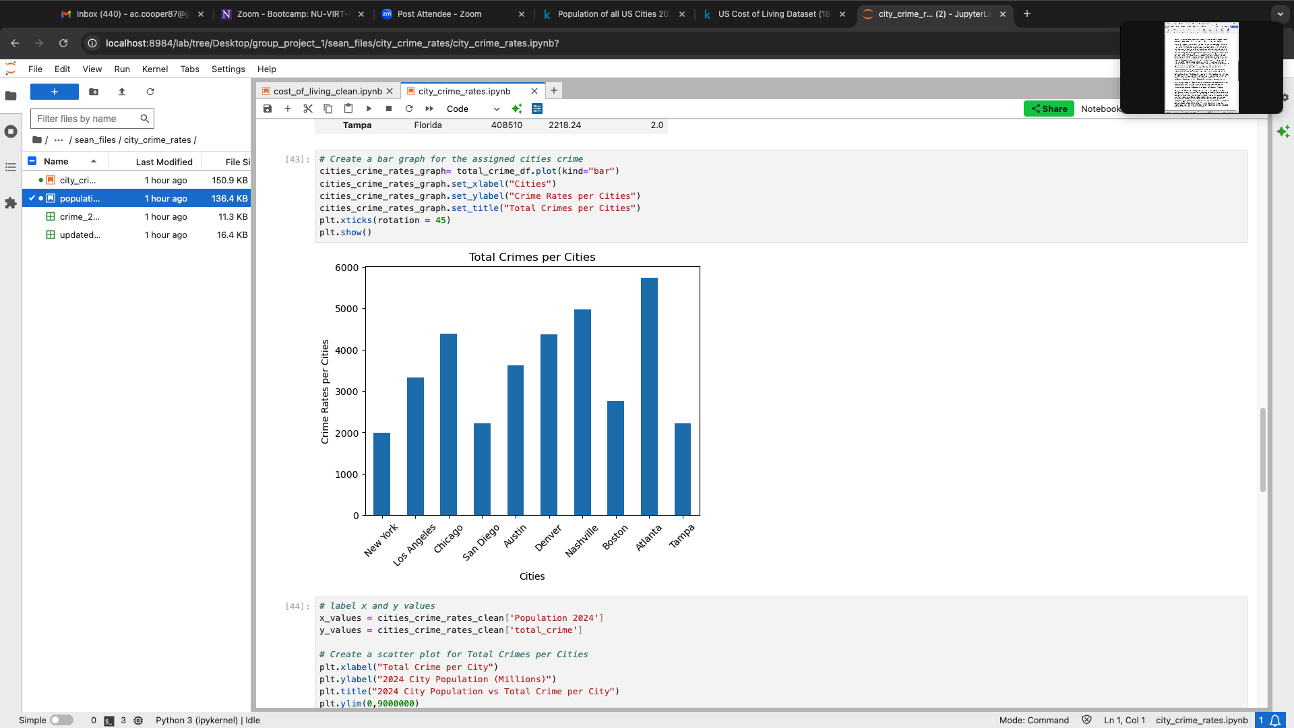
CITY CRIME
Data_Slack{ers}=False

Slide 14
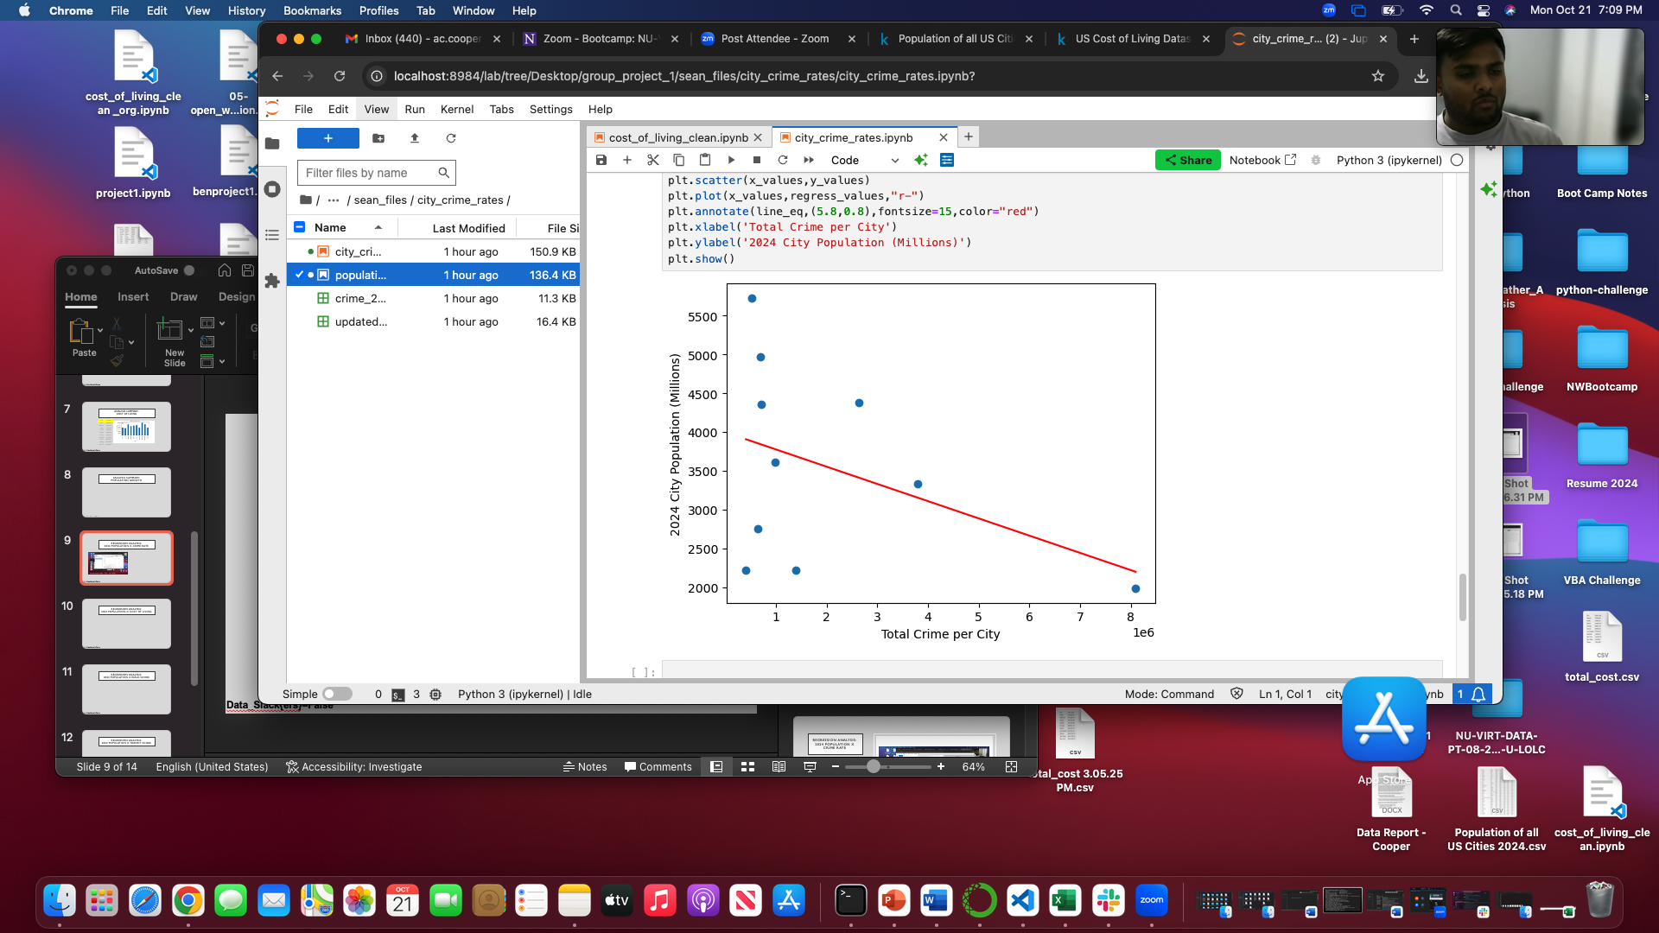
2024 CITY Population X Crime Rate R=-.42
Data_Slack{ers}=False

Slide 15
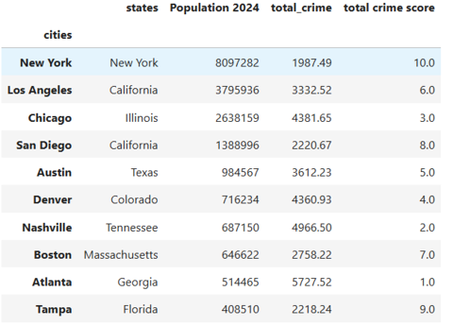
CRIME RANK
Data_Slack{ers}=False

Slide 16
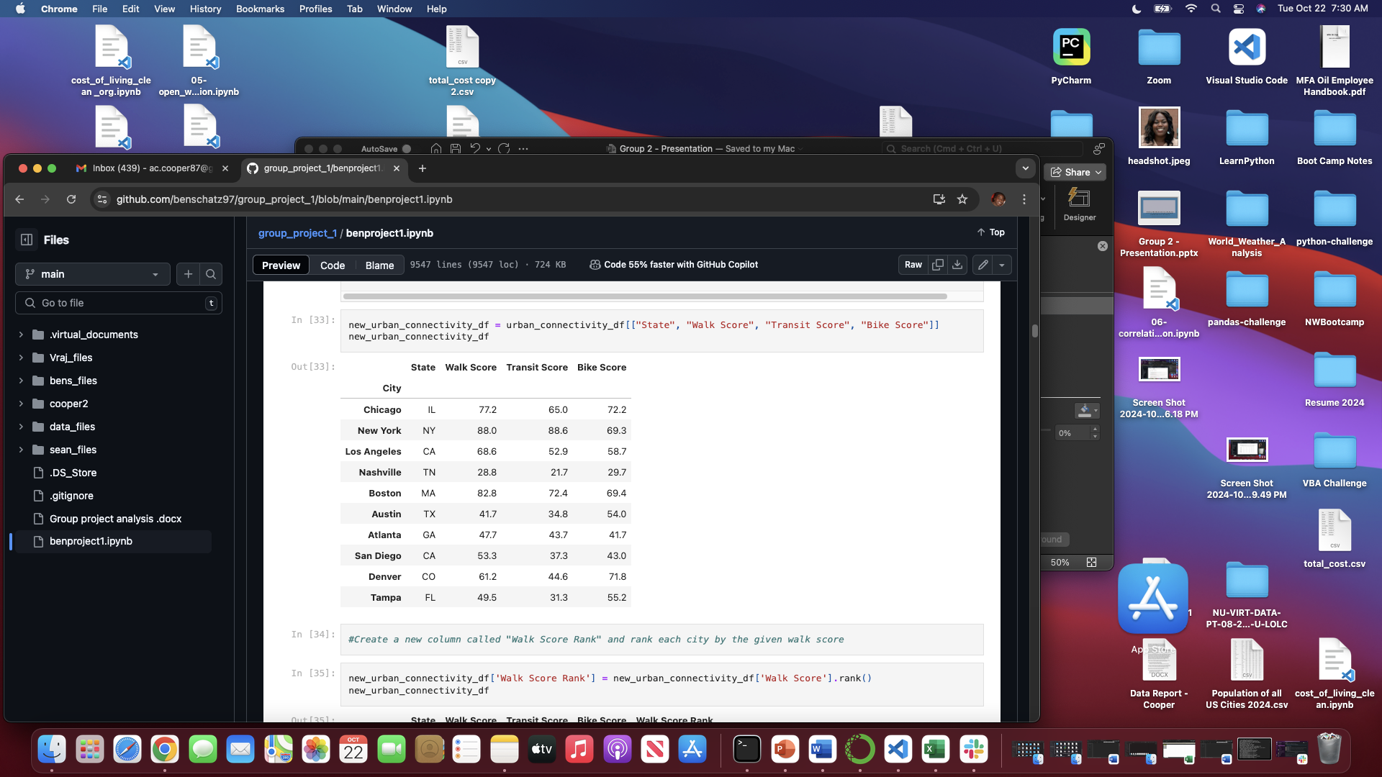
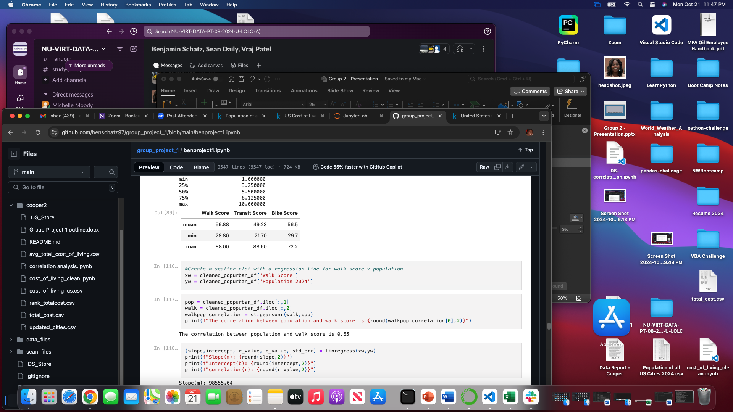
CLEANING Data – URBAN CONNECTIVITY
https://www.kaggle.com/code/vellis1/us-cities-urban-connectivity-data-collection/output?select=urban_connectivity.csv
Data_Slack{ers}=False

Slide 17
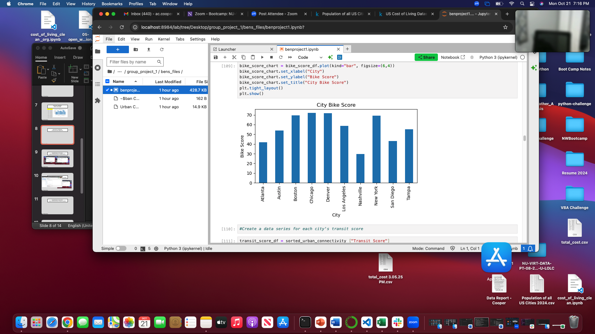
Urban Connectivity – Bike Score
Data_Slack{ers}=False

Slide 18
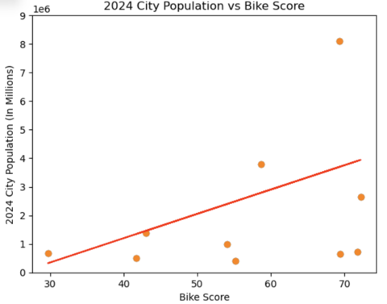
2024 CITY Population X BIKE SCORE R=.36
Data_Slack{ers}=False

Slide 19
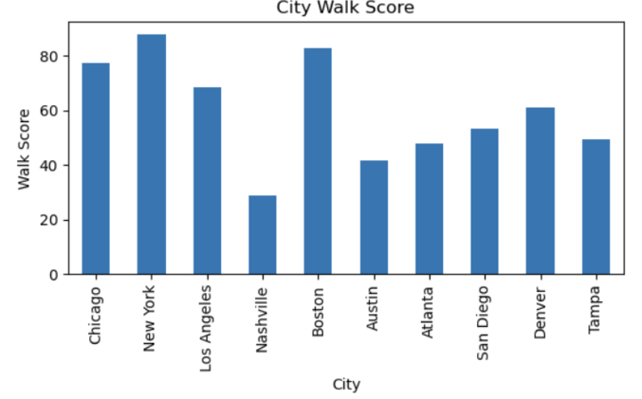
Urban Connectivity – WALK Score
Data_Slack{ers}=False

Slide 20
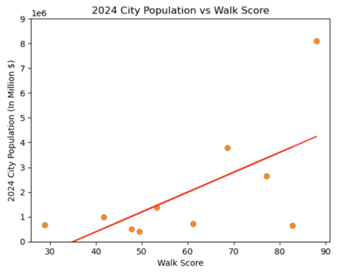
2024 CITY Population X WALK SCORE R=.64
Data_Slack{ers}=False

Slide 21
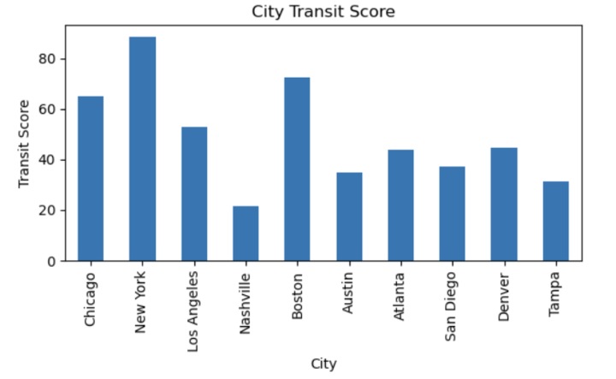
Urban Connectivity – TRANSIT Score
Data_Slack{ers}=False

Slide 22
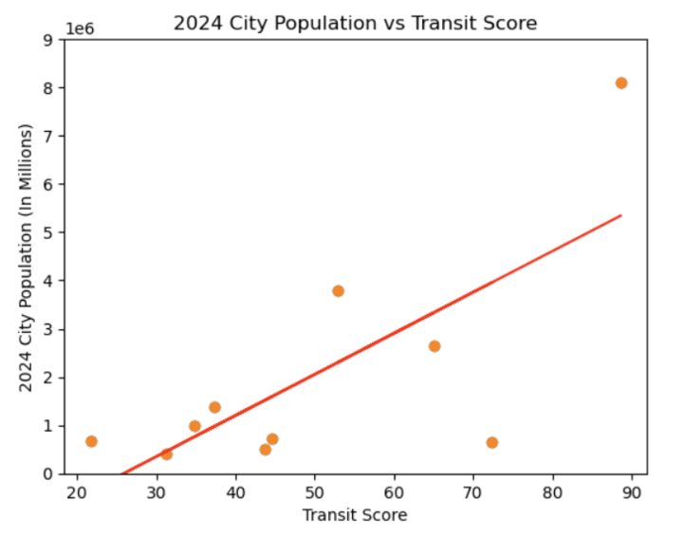
2024 CITY Population X TRANSIT SCORE R=.74
Data_Slack{ers}=False

Slide 23
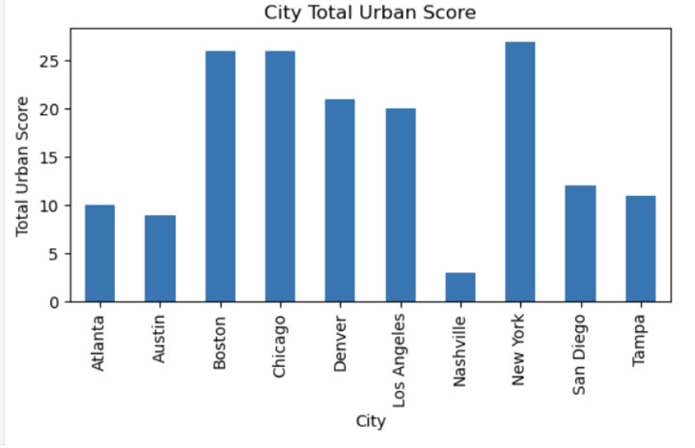
Urban Connectivity – TOTAL URBAN SCORE
Data_Slack{ers}=False

Slide 24
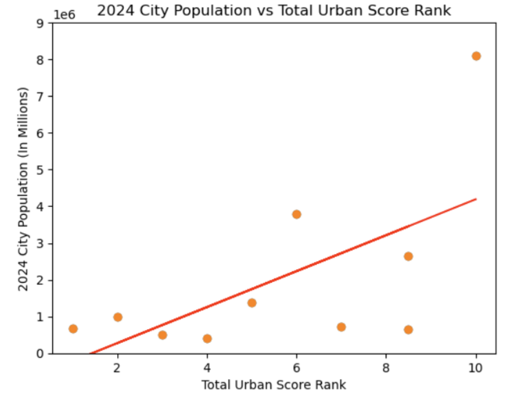
2024 CITY Population X TOTAL URBAN SCORE r=.61
Data_Slack{ers}=False

Slide 25
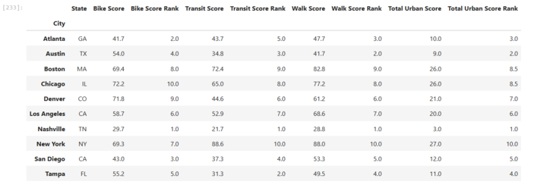
ScoRE RANK
Data_Slack{ers}=False

Slide 26
Where are we going to live next?
Data_Slack{ers}=False

Slide 27
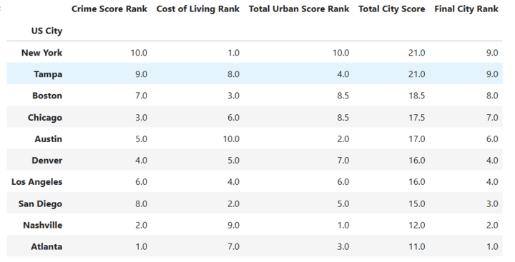
TOTAL CITY RANK
Data_Slack{ers}=False

Slide 28


NEW YORK CITY
TAMPA
Data_Slack{ers}=False

Slide 29
LIMITATIONS
Rewrite programming
More cities, more variables
Add in additional data - restaurants and school district/education
Understanding why some cities had multiple rows of data – cost of living
Obtaining information about the demographics of the information presented
Data_Slack{ers}=False

Slide 30

Questions
Data_Slack{ers}=False

